Slide 1
Customer Review Sentiment Analysis
NLP Sentiment Analysis
GROUP-5: PARTICIPANTS
Abhiram | Pravin | Shamil | Shubham | Shreya | VenuGopinath | Waquar

Slide 2
Dataset overview
A clean, analysis-ready corpus of mobile customer reviews.
1,440
REVIEWS
3
COLUMNS
0
MISSING / DUPLICATES
3.17
MEAN RATING
Rating distribution • range 1–5 • SD 1.58
35%
30%
25%
20%
15%
10%
5%
Share
0%
1★
2★
3★ Rating
4★
5★
02 / DATA

Slide 3
Business Requirements
Automated Feedback Processing: Ingest and classify high volumes of unstructured customer feedback (reviews, support tickets, social media) in real time.
Aspect-Based Categorization: Map sentiment to specific operational drivers (e.g., product features, customer support quality).
Automated Escalation: Trigger immediate alerts for critical negative feedback or high-risk customer complaints.
Strategic Goals
Increase Retention : Proactively identify customer pain points to reduce churn and increase overall customer satisfaction.
Brand Protection: Monitor brand health across channels to catch public relations or product defect issues early.
Operational Efficiency: Replace manual review inspection with automated NLP triage, saving analyst and support team hours.

Slide 4
From raw text to signal
A repeatable pipeline strips noise while preserving customer meaning.
AFTER
“love phone camera”
BEFORE
“LOVE 10/10 | this phone!!! Camera — visit http://…” | is
1 lowercase + strip URLs / HTML
2 remove non-ASCII, punctuation, numbers
3 drop stopwords + short tokens
4 WordNet lemmatization
4 empty reviews removed → FINAL CORPUS 1,436
03 / PREPROCESS

Slide 5
What customers talk about
6,002
WORDS IN VOCABULARY
Top terms • indexed frequency
phone
NEGATIVE • 1–2★
Battery drain Heating issues
Camera disappointment Value concerns
POSITIVE • 4–5★
Camera quality Smooth performance Display clarity Overall value
good
camera
battery
Term
samsung
screen
use
product
great
quality
0
20
40
60
80
100
Relative frequency
04 / THEMES

Slide 6




Labels turn stars into sentiment
A pragmatic three-class mapping reveals a meaningful imbalance.
Positive
Neutral 13.9%
Negative
Neutral
1–2 ★ → NEGATIVE | 508
3 ★ → NEUTRAL | 199
Positive 50.8%
Negative 35.4%
4–5 ★ → POSITIVE | 729
05 / LABELS

Slide 7
Build features. Preserve balance.
TF–IDF converts cleaned language into a compact, model-ready representation.
tfidf = TfidfVectorizer(max_features=5000)
X = tfidf.fit_transform(clean_reviews)
X_train, X_test, y_train, y_test = train_test_split( X, y, test_size=0.20, stratify=y, random_state=42)
1,148
TRAIN • 80%
288
TEST • 20%
5 , 000 FEATURES • STRATIFIED SPLIT
06 / FEATURES

Slide 8
Three models enter the test
Same features. Same split. A fair comparison across linear and ensemble approaches.
01 |  | 02 |  | 03
Logistic Regression |  | Random Forest |  | Linear SVM
Balanced baseline |  | 200 estimators |  | Margin-based classifier
Regularized linear classifier |  | Nonlinear ensemble |  | Optimized for sparse text
Evaluation: weighted precision • recall • F1 • accuracy
07 / MODELS

Slide 9
Why Chose these Three Machine Learning Models?
Logistic Regression (Baseline & Efficiency): Fast to train and highly interpretable, performing exceptionally well on high-dimensional, sparse TF-IDF text features with linear decision boundaries.
Random Forest (Non-Linearity & Robustness): Captures complex word interactions and feature dependencies while reducing variance/overfitting through decision tree ensemble bagging.
SVM (Optimal High-Dimensional Separation): Maximize margin separation between sentiment classes in high-dimensional vector spaces, making it highly effective for text boundary classification.

Slide 10


Linear SVM leads on weighted F1
Performance on the 288-review held-out test set.
Accuracy
Weighted F1
80%
BEST MODEL
73.3%
weighted F1 Linear SVM
60%
40%
20%
0%
Logistic Regression
Random Forest
Linear SVM
08 / RESULTS

Slide 11
Strong at the poles. Weak in the middle.
Linear SVM class-level performance and confusion matrix.
CLASS
P
R
F 1
CONFUSION MATRIX
Pred −
Pred 0
Pred +
NEGATIVE
0.72
0.81
0.76
Actual −
83
4
15
NEUTRAL
0.50
0.17
0.26
Actual 0
18
7
15
POSITIVE
0.81
0.88
0.84
Actual +
15
3
128
09 / ERROR ANALYSIS

Slide 12
The neutral-class problem
The model is useful today—but its blind spot is clear.
01
IMBALANCE
02
AMBIGUITY
03
NEXT MOVE
Only 199 Neutral reviews constrain what the model can learn.
Mixed or understated opinions are easily pulled toward either pole.
Augment Neutral data and test contextual language models.
10 / LIMITATIONS

Slide 13

From notebook to live prediction
A lightweight deployment path makes sentiment available in real time.
model = load('sentiment_model.pkl') tfidf = load('tfidf_vectorizer.pkl') vector = tfidf.transform([review]) sentiment = model.predict(vector)[0]
“This product is amazing and I really love it”
→ POSITIVE
11 / DEPLOY

Slide 14
Ready to listen at scale.
CONCLUSION
01
REFINE
Linear SVM delivers effective sentiment classification and is deployment-ready. The next gains will come from better Neutral-class balance, broader datasets, and real user feedback loops.
02
EXPAND
03
LEARN
Questions?
12 / THANK YOU

Slide 15
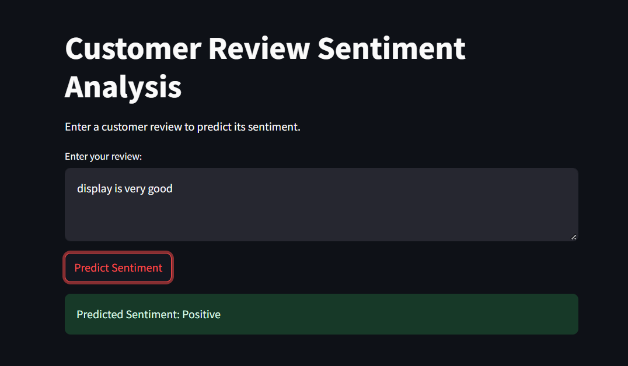
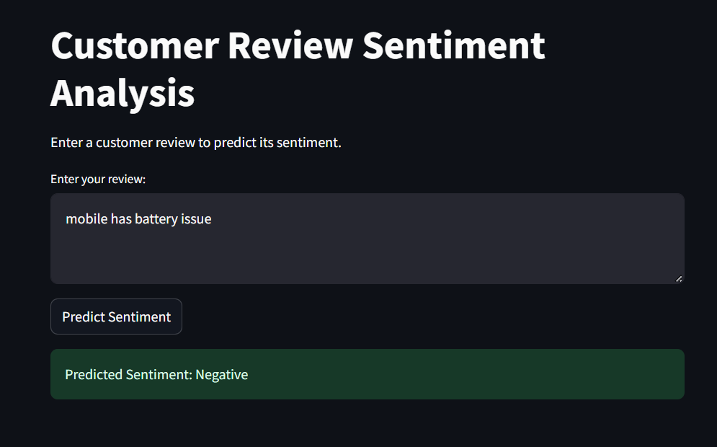
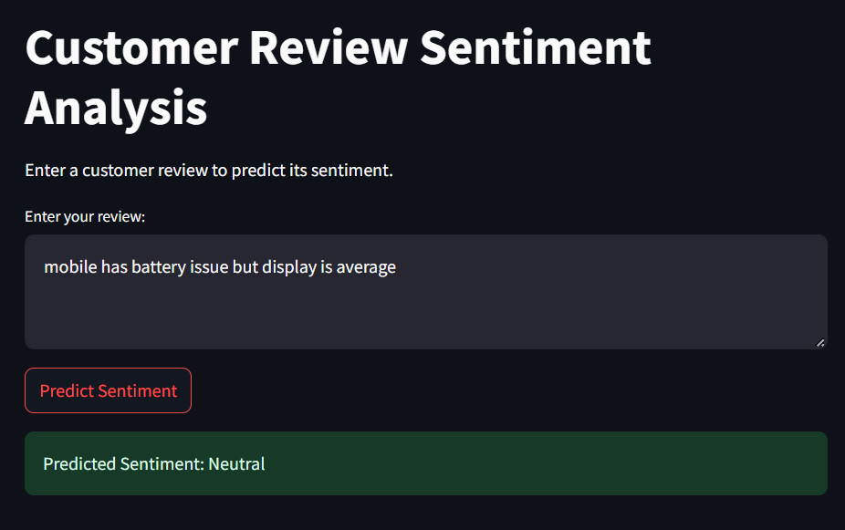
Predicted Sentiments

Slide 16
Data & Project Challenges
Class Imbalance: Datasets are small and often skewed toward positive reviews (4 & 5 stars), making it difficult for models to accurately detect subtle negative feedback.
Sarcasm & Contextual Ambiguity: Words like "Great, another defective product!" contain positive keywords ("great") but convey negative sentiment, tricking traditional TF-IDF representations.
Aspect Overlap: Distinguishing between sentiment tied to product quality versus delivery/packaging was difficult when both were mentioned in a single review.
Handling Unseen Vocabulary: Models Can struggled with newly emerging slang or product-specific terms not present in the historical training split.

Slide 17
Thank You

